Slide 1
Data Flow Diagram for RideEase

Slide 2
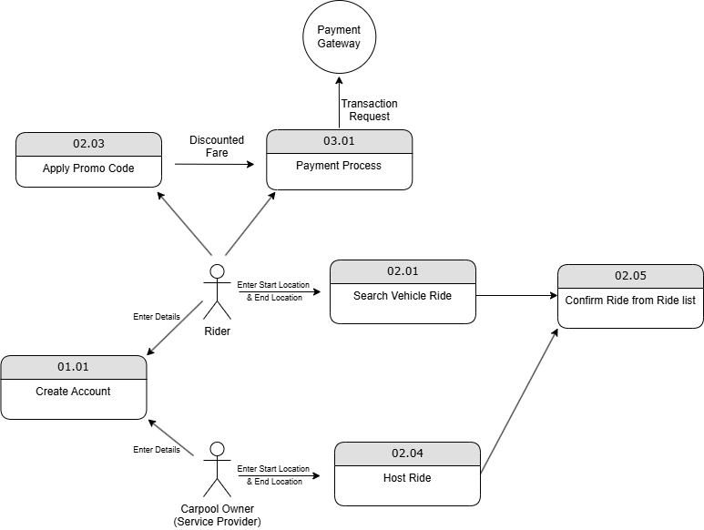
Logical-Data Flow Diagram - 1

Slide 3
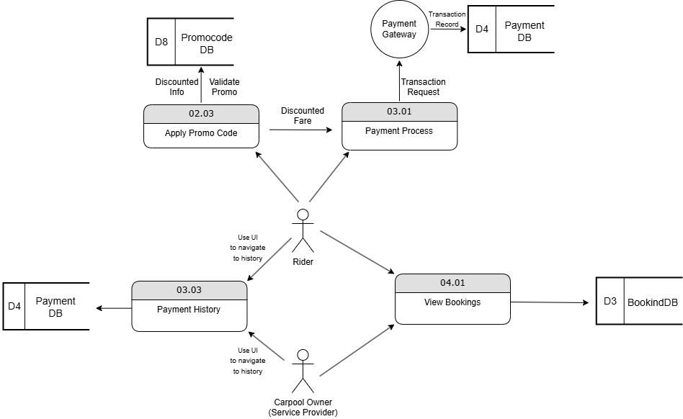
Physical-Data Flow Diagram -1

Slide 4
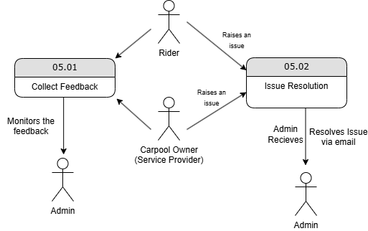
Logical-Data Flow Diagram - 2

Slide 5
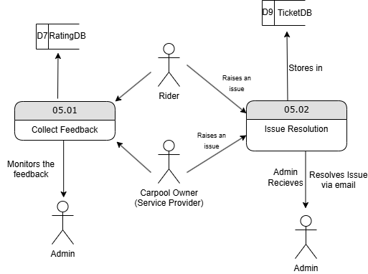
Physical-Data Flow Diagram - 2

